Slide 1
MODULE 2 ..PART1..IRS INFORMATION RETRIEVAL MODELS
I
1) Information retrieval system
1.1)Database formation….Database manager
1.2) Database to logical view….operations on data
1.3) indexing… The objective of indexing is
1.3.a) To organize and categorize information in a way that makes it easier to retrieve and access.
1.3.b) It involves creating a list of keywords or terms associated with specific pieces of information, making it easier to find relevant information quickly.
1.3.c) Indexing reduces the documents to the informative terms contained in
Them

Slide 2
MODULE 2 ..PART1..IRS INFORMATION RETRIEVAL MODELS
I
1) Information retrieval system
1.4) Index..
a) Identification of specific attributes of the document or sentence as per the query so as to simplify and expedite accurate document revival
b) Indexing of documents: It is collection of keywords which mostly occur in the document. So that they can be used for fast search (document side)
c) Indexing of user query: It is collection of keywords of user query sentence

Slide 3
MODULE 2 ..PART1..IRS INFORMATION RETRIEVAL MODELS
(1)Information retrieval system
d.. ) indexing process
d.1)Sentence….india srilanka cricket match.
d.2) The sentence is parsed and words, numbers, spaces symbols are separated
d.3) This sentence has words…india, srilanka, cricket and match
d.4) Spaces…yes…between words
d.5)Numbers…no numbers
d.6)Symbols….yes…fullstop
d.7) These are called as tokens

Slide 4
MODULE 2 ..PART1..IRS INFORMATION RETRIEVAL MODELS
(1)Information retrieval system
1.4)The process( token of Doc matched with keywords of query)
a) The keyword representation of the query sent by the user is then matched with the indexing representation of the documents(tokens)
b) The documents which are matching are selected
c) They are then ranked as per the nearness of their matching from top to bottom
1.5) Limitation of the process…
a)When the sentence is represented as words its meaning is lost or changed

Slide 5
MODULE 2 ..PART1..IRS INFORMATION RETRIEVAL MODELS
(1)Information retrieval system
1.5) Limitation of the process…cont
b)Thus the matching between the user query and documents usually give irrelevant search
c) If the user is not able to form the proper query sequence then the results are still bad
d) Document at the top of the rank is considered to be most relevant as compared to others. This all depends on the accuracy of the ranking algorithm or the ranking functions.
e)As per the conditions used, the ranking function varies and as per the ranking function used, different IR models are present

Slide 6
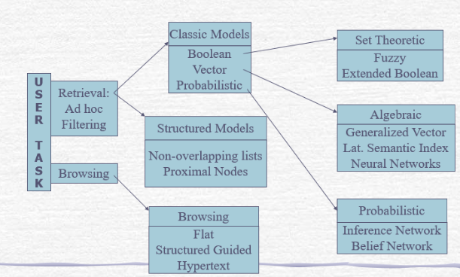
MODULE 2 ..PART1..IRS
(1)taxonomy of Information retrieval system

Slide 7
MODULE 2 ..PART1..IRS
(1)taxonomy of Information retrieval system
1.2) User task…what the user wants to do
a)Two process......process one …information retrieval
a.1)Information or data retrieval…..query formation..the user sent the query…query indexing(keywords)…documents indexing(tokens)..matching…ranking
a.2)Two operational modes used by the users…..adhoc and filtering
a.2.1)Operational mode one:……Adhoc…
The document number in the collection of IR system remains same
Only the queries sent to the IR system changes
This was the conventical IR system were the database was isolated

Slide 8
MODULE 2 ..PART1..IRS
(1)taxonomy of Information retrieval system
1.2(User task…information retrievel….users operational modes…adhoc
a)Eg the result IR system, the number of student entries and number of mark entries will be fixed only the queries will change like number of students passes, number of students failed and so on
b) Currently this is not used as the IR system is static.
c) Currently due to online application, and change in information value ( what is today may not be of any use tomorrow) dynamic and updated information is required.
d) This is easily available from WWW
1.3) Operational mode two: Filtering…

Slide 9
MODULE 2 ..PART1..IRS
(1)taxonomy of Information retrieval system
1.2(User task…information retrievel….users operational modes…filtering
Operational mode two: Filtering…
User profile
Filtering algorithm
Data base manager
database
User inputs

Slide 10
MODULE2 ..PART1..IRS
1.2(User task..IR….users operational modes…filtering
1.2.a) User profile:
a) users will enter his requirements in form of keywords. Thus the users profile will be created.
b) Filtering algorithm : this will act as the input to the profile created
c) From the profile the statement of keywords will be indexed .
d) The documents in the database will be indexed with tokens
e) This will be compared in the filtering unit by filtering algorithm
f) The filtered documents will be presented to the user
g) The count of number of documents and number of sets required can be set in the filtering algorithm if required

Slide 11
MODULE2 ..PART1..IRS
(1)taxonomy of Information retrieval system
1.2(User task…information retrievel….users operational modes…filtering …… 1.2.a)User profile:
h) The filtered documents will be presented to the user
i) The cut of number and number of sets required can be set in the filtering algorithm if required
1.2.b) Database manager….will manage all data relation operations
1.2.c) Database….this is data on which different operations will be performed. Different views of this database will be shown as per the requirement. In case of retrievel, the logical view of the required document is shown

Slide 12
MODULE2 ..PART1..IRS
Information retrieval system
2) Information retravel(IR) and data retrievel (DR)
2.4) DR is well structured were as IR can be unstructured also
2.5) DR semantically very clear were as IR, more pains have to be taken to make it semantically clear
2.6)DR gives clear idea of the database system and IR puts a abstraction layer for database system
2.7)DR, result matching is perfect, in IR result matching may not be perfect
2.8)DR, deterministic model and IR is probabilistic model

Slide 13
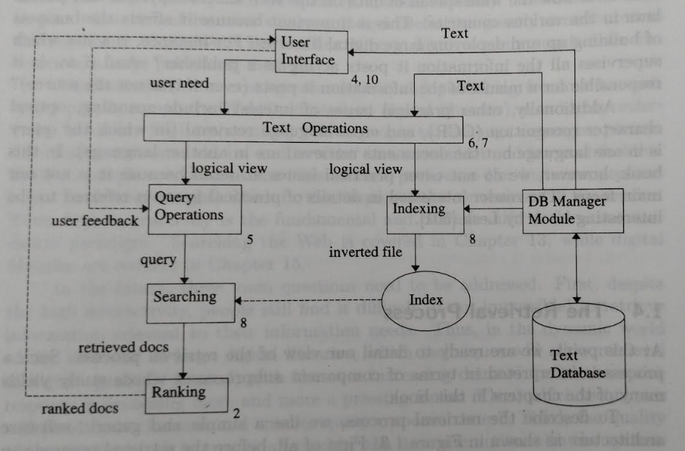
MODULE2 ..PART1..IRS
3)Information retrieval process…

Slide 14
MODULE2 ..PART1..IRS
3) Information retrieval process…
3.1)Software architectural model of IR process
Part1: storage and indexing
Data base creation, i.e defining the text database. This is done by database manager
What is specified.. documents to be used, operations to be performed, text model i.e the text structure and what elemnts to be retrieved from it
Based on the operations , the text operations trnsforms the original document to a logical view of it.

Slide 15
MODULE2 ..PART1..IRS
Information retrieval process…
Software architectural model of IR process
Part1: storage and indexing
Then a index is assigned to this logical document by the database manager.
Part2: retravel process…
The user through user interface gives user needs
As per the need text operations are decided by parseing
The text operations are then represent as query operation

Slide 16
MODULE2 ..PART1..IRS
Information retrieval process…
Software architectural model of IR process
Part2: retravel process…
The searching of the document is done by using indexing and the required document is retrieved
Part3:query response to user
Before sending to the user the documents are ranked as per their relevance
the documents are then grouped as sets and the most relevant set is sent first to the user

Slide 17
MODULE2 ..PART1..IRS
3) Information retrieval process…
Software architectural model of IR process
Part3:query response to user
The user if not satisfied initiates a feedback which is then send for searching of the relevant documents
4)Search engines….
A search engine is a software system designed to carry out web searches.
web search sents web search query which the user enters into a web search engine to satisfy their information needs.

Slide 18
MODULE2 ..PART1..IRS
Thank You

